Slide 1
Lae-Dep
Acumen Animus
Group 6 final presentation.

Slide 2
The “Seth Algorithm”
Determines user’s score.
Default Color Values.
X = (color + shape + font)
Score = normalized X
A - Color Scoring
 | Rank 1 | Rank 2 | Rank 3 | Rank 4 | Rank 5
Light | 1.5 | 2.5 | 3.5 | 4.5 | 5
Dark | 0.5 | 1 | 2 | 3 | 4
B - Shape Scoring
Triangle | Lines | Hexagon | Square | Circle
1 | 2 | 3 | 4 | 5
C - Font Scoring
Nuetra | Franklin Gothic Book | Baskerville | Georgia | Helvetica
1 | 2 | 3 | 4 | 5
X Score Range
Score Lowest Highest
1 0.83 3.67
2 3.68 6.50
3 6.51 9.33
4 9.34 12.17
5 12.18 15.00

Slide 3
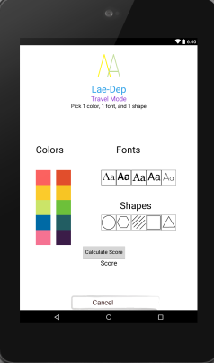
Travel Mode
Uses Seth algorithm to determine score.
Displays score.
Displays a motivational Phrase.
Note: Default Preference Values.

Slide 4
AR Implementation
“Technology that superimposes a computer-generated image on a user's view of the real world”
Displays motivational message in 3D with target image.
Currently unsupported by similar colors.
Alternate designs.

Slide 5
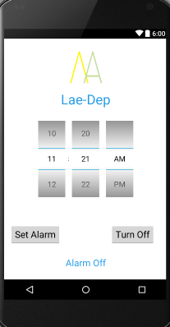
Alarm Clock Feature
Sets time & displays time Alarm is set to go off.
5 Soothing Tones.
Tone Selection.
Repeat Schedule.
Motivational Phrase Supplement.

Slide 6
Realizing Design
Original Design: http://adobe.ly/1pKcYCZ
Nearly same navigation.
Same Assets as Planned.

